Slide 1

Django Models
and Databases

Slide 2
Django
Let’s quickly revisit our simple model of how Django works...

Slide 3


Django
Python File
with
URL Routing
HTML
CSS
JS
{{JINJA}}
Python File
Using Django Models
User Browser
Database
Models
Template
Python File
Using Django
Application
Logic
in Python
View

Slide 4
Django
Python File
with
URL Routing
HTML
CSS
JS
{{JINJA}}
Python File
Using Django Models
User Browser
Database
Models
Template
Python File
Using Django
Application
Logic
in Python
View

Slide 5
Django
Models allow us to interact with a database with Python and Django.
This includes the key interactions with a database - CRUD:
Create
Read
Update
Delete

Slide 6
Django
In this section we’ll be exploring how to store, retrieve, update, and delete data from a SQL based database using Django’s built-in models tools and functionality.

Slide 7
Django
Section Overview
Database Overview
Models and Databases
Creating Models and Fields
Migrations
Data Interaction - CRUD
Database and Template Interaction

Slide 8
Let’s get started!

Slide 9
Databases
Overview

Slide 10
Django
Put simply, databases allow us to store information that we can use on our website.
We should briefly cover how SQL based databases work so we can understand the Django Models analogous operations that interact with the database.

Slide 11
Django
SQL databases are tabular, similar to a spreadsheet, like Excel.
But we often get questions like: “What about NoSQL, such as MongoDB?”
Let’s quickly explore the visual difference between the two...

Slide 12
Django
SQL stores data in a tabular format:
NoSQL stores data in a key/value pair format:
{“id”:0, “name”: “John”, “color”: “blue”}
{“id”:1, “name”: “Mary”, “color”: “red”}
id | name | color
0 | John | blue
1 | Mary | red

Slide 13
Django
Which is better? NoSQL or SQL?

Slide 14
Django
Which is better? NoSQL or SQL?
One format is not better than another, they are simply different.
Django Models is designed to work really well with a tabular SQL based format, so that is what we will choose.

Slide 15
Django
For most applications SQL will be completely fine, and if you are beginning with Django you should try to stick to SQL before making a jump to NoSQL.
You should also carefully consider if NoSQL actually provides a major advantage to your project.

Slide 16
Django
Now, what type of SQL to choose?
There are lots of options!
MySQL
SQLite
PostgreSQL
MS SQL
...and many more!

Slide 17
Django
Django is pretty agnostic to most major SQL engines with the use of its Django Models system, so switching to another SQL engine is more a matter of updating settings.py rather than rewriting the actual Python Django code.

Slide 18
Django
Since this is the case, we’ll use SQLite as its already included and installed along with Python.
While typically thought of as a smaller scale SQL engine, for many use cases SQLite performs fine.
www.sqlite.org/whentouse.html

Slide 19
Django
From the official website of SQLite:
“Generally speaking, any site that gets fewer than 100K hits/day should work fine with SQLite. The 100K hits/day figure is a conservative estimate, not a hard upper bound. SQLite has been demonstrated to work with 10 times that amount of traffic.”

Slide 20
Django
Let’s continue to explore these concepts by discussing Django Models.
Once you learn about Models, you will begin to clearly see why SQL is probably the better choice in regards to starting out with Django.

Slide 21
Models and
Databases

Slide 22
Django
Django Models are defined inside a Django app (or project) models.py file.
The models class operates on a system which directly converts Python based code into SQL commands.
This makes it much easier to work with the backend database.

Slide 23
Django
Creating a Model is similar to creating a new table in a database.

Slide 24
Django
Creating a Model is similar to creating a new table in a database.
Database (SQLite)

Slide 25
Django
Creating a Model is similar to creating a new table in a database.
Database (SQLite)
Customers

Slide 26
Django
Creating a Model is similar to creating a new table in a database.
Database (SQLite)
Food Items
Customers
Employees

Slide 27
Django
Creating a Model is similar to creating a new table in a database.
Database (SQLite)
Food Items
Customers
Employees

Slide 28
Django
Creating a Model is similar to creating a new table in a database.
Database (SQLite)
Food Items
Customers
Employees

Slide 29
Django
Each database table has a name and then columns, where each column will have a specific data type, for example: character strings for names or integers for ages in years.
Let’s now explore how Django Models works in conjunction with these structures.

Slide 30
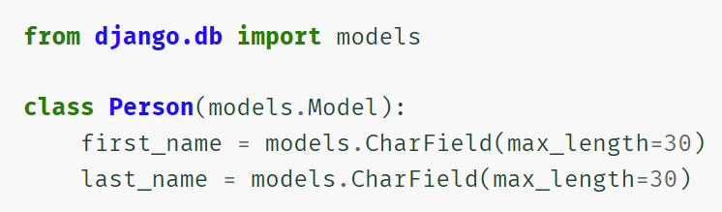
Django
Inside of models.py:

Slide 31
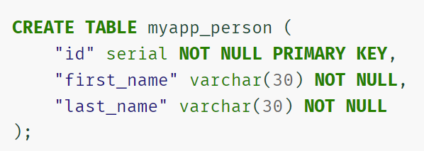
Django
Inside of models.py:
Automatically converted to SQL:

Slide 32
Django
Django Model Key Concepts:
Inherits from models class.
Uses fields to define both data types and data constraints.
For example, you may want to require information, like a user’s email address, in which case you can add a NOT NULL constraint.

Slide 33
Django
Django Model Key Concepts:
Inherits from models class.
Uses fields to define both data types and data constraints.
You may want to require unique entries, like a unique user email (no duplicate accounts) with a UNIQUE constraint.

Slide 34
Django
Fields are chosen for data type:

Slide 35
Django
Field arguments specify constraints:

Slide 36
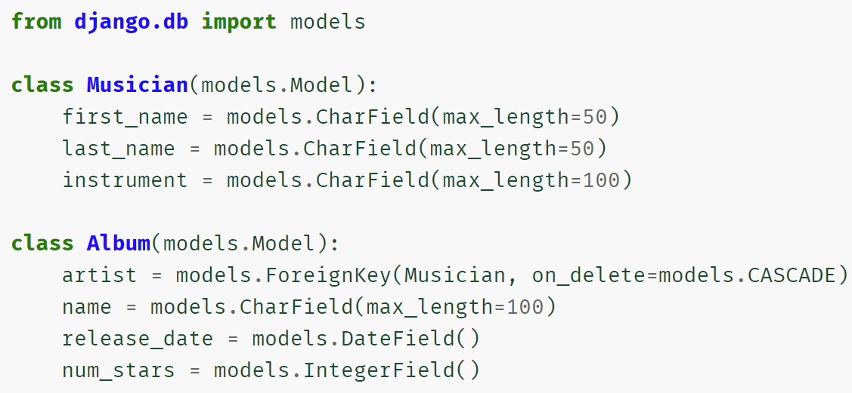
Django
Django Models can also be connected through keys:

Slide 37
Django
Let’s continue our discussion by exploring how to create a model and add fields.
Later on in future sections we’ll be able to drastically advance our Django abilities by automatically creating templates simply by connecting them to a model (Class Based Views).

Slide 38
Creating
Models and Fields

Slide 39
Django
In this lecture we will:
Create a new project and app.
Register a database in settings.
Run a migrate command to create the database (python manage.py migrate).
Create an example model with fields.

Slide 40
Django
Let’s imagine we’ve been hired by a dentist office to create some software for their office to keep track of patients.
It would be great if we could store patient information in a database, like their name and age.

Slide 41
Django
To do this, we’ll also be exploring the documentation as we code along, including:
Setting up databases in settings.py.
Different backends available.
Different fields that are available for Django Models.

Slide 42
Django
Note, in the next lecture we’ll continue with a further discussion on migrations, including the makemigrations command.
Let’s get started!

Slide 43
Migrations

Slide 44
Django
In general, migrations is the act of connecting changes in your Django project or app to the database.
This includes things like adding new models within an application, adding a new application, updating models with a new column/attribute, and more.

Slide 45
Django
You typically see these commands done through the manage.py file.
Let’s discuss the migrate based commands you can run:
makemigrations
migrate
sqlmigrate

Slide 46
Django
python manage.py makemigrations app
This actually creates (but does not run) the set of instructions that will apply changes to the database.
Note, the default applications in Django (e.g. Admin, Auth) already have their SQL makemigrations code ready (just not run yet).

Slide 47
Django
python manage.py makemigrations app
You can actually see these migration files created under:
app
migrations
0001_initial.py

Slide 48
Django
python manage.py migrate
Runs any existing migrations (typically created through the makemigrations command).
This is actually running the files under the migrations directory from the previous command.

Slide 49
Django
python manage.py sqlmigrate app 0001
If you ran make migrations, then you’ve already created a migration .py code file.
If you wanted to see what the SQL code looked like, you could run the sqlmigrate command to view it.

Slide 50
Django
Note that typically we won’t review the files created under the migrations directory or run sqlmigrate, we’ll simply run makemigrations and migrate.
You can think of the very first migrate command we run as executing the default makemigrations that was already created for you upon creating the project.

Slide 51
Django
Steps for migrations:
Initial project migrate command
Create app and create models
Register app in INSTALLED_APPS in settings.py
Run makemigrations for new app
Run migrate for new migrations

Slide 52
Django
Let’s explore these concepts based on the Patient model class created in the previous lecture!

Slide 53
Data Interaction:
Creation and Insertion

Slide 54
Django
Inserting new data into a SQL table is easy with Django Models.
Since the models are represented by a class, we can easily create a new instance of the class object in Python, and then call the .save() method to create an INSERT call to the SQL database.

Slide 55
Django
Alternatively, you can use the built-in .objects.create() method to both create and save the new data entry in a single line.

Slide 56
Django
In instances where you want to create multiple new data entries in bulk, you can use the .objects.bulk_create() method to pass in a list of newly created objects.

Slide 57
Django
Let’s explore these 3 methods of creating new data entries with a model:
Create Object and .save()
objects.create()
objects.bulk_create()

Slide 58
Data Interaction:
Reading and Querying

Slide 59
Django
Each Model you create comes with a Manager that allows you to create a QuerySet which can then be used to retrieve entries from the database.
Keep in mind that the QuerySet is actually lazily evaluated, meaning that it doesn’t hit the database until its explicitly asked to grab the information.

Slide 60
Django
Recall we used something like:
MyModel.objects
This is the Django Model Manager.
This Manager can then actually read the database through the use of method calls, like .all() and .get() and narrow down results with .filter() and .exclude()

Slide 61
Django
In this lecture we’re going to focus on the .all() method which allows us to grab all the entries in a database table.
Typically, we won’t want everything, so we’ll need to filter our results, but we’ll discuss that in more detail later on.

Slide 62
Django
Great resource on queries with examples:
docs.djangoproject.com/en/4.0/ topics/db/queries/
For now let’s explore the basics of reading in data from the database and what changes we can make to the model to make results more human readable.

Slide 63
Data Interaction:
Filtering
filter() and get()

Slide 64
Django
The .get() operation allows us to grab a single item from the Model table.
This is typically reserved for something where you are sure there is only a single unique entry, like the default primary key that is automatically created by Django (pk=N).

Slide 65
Django
If we want to further filter our results (rather than grab all or get a single item), we can use the .filter() method to narrow down based on conditions.
The .filter() methods can be chained together.

Slide 66
Django
Django also provides operators for QuerySets, which allows us to directly use logic like AND and OR.
These operators need to be imported from django.db.models from the Q function.

Slide 67
Django
Let’s explore the following topics:
Using .get()
Using .filter()
Using operators

Slide 68
Data Interaction:
Filtering with
Field Lookups

Slide 69
Django
So far we’ve had to use equality statements in our filtering (age=30 or last_name= ‘smith’).
But what about more general comparison operators:
Greater than or less than
Starts with

Slide 70
Django
For more complex filtering operations we use field lookups with a filter() call:
Model.objects.filter()

Slide 71
Django
For more complex filtering operations we use field lookups with a filter() call:
Model.objects.filter(name)

Slide 72
Django
For more complex filtering operations we use field lookups with a filter() call:
Model.objects.filter(name__)

Slide 73
Django
For more complex filtering operations we use field lookups with a filter() call:
Model.objects.filter(name__startswith)

Slide 74
Django
For more complex filtering operations we use field lookups with a filter() call:
Model.objects.filter(name__startswith= “s”)

Slide 75
Django
There are many field lookup calls available:
docs.djangoproject.com/en/4.0/ref/ models/querysets/#field-lookups

Slide 76
Django
Let’s explore a few of these field lookup methods!

Slide 77
Data Interaction:
Updating Models

Slide 78
Django
There may come a time when you need to create a new column or attribute for a model.
You can easily update existing models by simply adding a new model class attribute and then migrating those changes.

Slide 79
Django
You should note that when adding new fields, the existing entries will need to have some default value inserted (even if it’s just null).
In fact, when we attempt to run migrations without taking care of these issues, Django will specifically request us to make a decision.

Slide 80
Django
You’ll be given two options:
Choose a default value on the spot when making the migrations file.
Cancel the migration and create a default value within the model.
It’s usually more robust to have the default live in the model, but each case is different.

Slide 81
Django
Let’s explore these ideas further in our code, we’ll also touch on the idea of using validators with fields, which add hard-coded constraints that will reject non valid entries!

Slide 82
Data Interaction:
Updating Existing Entries

Slide 83
Django
Django makes it very easy to update existing entries.
You simply grab the existing data entry, update any attributes, then .save() the changes to write the update to the database table.
Let’s check it out!

Slide 84
Data Interaction:
Deleting

Slide 85
Connecting Data
To Templates

Slide 86
Django
You have a lot of the knowledge and tools needed to make a fully functioning website!
You know all the details necessary to connect a user to a backend database and have the user interact with the data (create, read, update, and delete).

Slide 87
Django
In this lecture, we’ll explore how we could report back information from the database to the user in a template.
However, we want you to keep in mind there are two major ideas we have yet to learn about...

Slide 88
Django
Two Major Features:
Django Forms
Allows Django to automatically create forms from Python to template.
Class Based Views
Automatically generates views based on a Model.

Slide 89
Django
These two features are so powerful that you should really learn them first before jumping straight into using Django based on what you know so far.
While we have a lot of capabilities already, those features will drastically reduce your development time!

Slide 90
Django
For now let’s show a simple example of a template that could be used report back information from a database.

